Slide 1

Authentication
Multifactor Authentication

Slide 2
Authentication
The process or action of verifying the identity of a user or process.

Slide 3

What types of authentication have you seen in your life?

Slide 4
Factors of Authentication
Something You Know
Something You Have
Something You Are
Somewhere You Are
Something You Do

Slide 5

Something You KNow

Slide 6
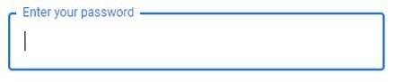
What is something you know?
Information that you have memorized, such as a password or a PIN.

Slide 7

Something You Have

Slide 8

What is something you have?
Something you physically carry on you, such as an ID Card or a Smartphone.

Slide 9

Something You are

Slide 10

What is something you are?
A physical trait that relates only to you, such as a fingerprint or your eyes.

Slide 11

Somewhere You are

Slide 12

What is Somewhere you are?
When a location is used for authentication, such as unlocking a phone when at home at a certain spot.

Slide 13

Something You Do

Slide 14

What is something you do?
A particular behavior that only you do, such as a routine you have.

Slide 15
Mutlifactor Authentication
The combination of two or more types of authentication to make something more secure.

Slide 16
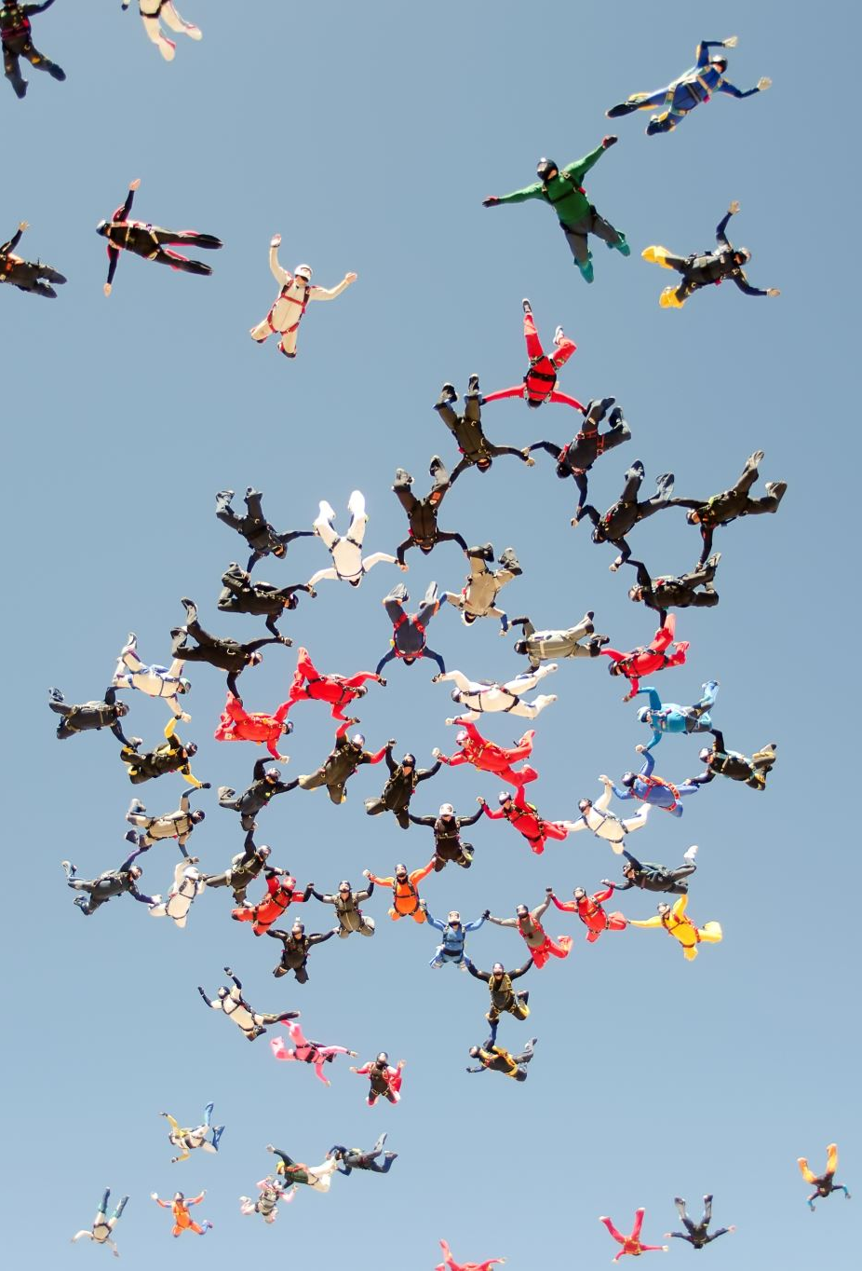
Group Activity

Slide 17

Wordsearch

Slide 18
Wrap Up
Something You Know
Something You Have
Something You Are
Somewhere You Are
Something You Do

